Slide 1
Fetch & Axios

Slide 2


Client Server Architecture
request
response
Client
Server

Slide 3
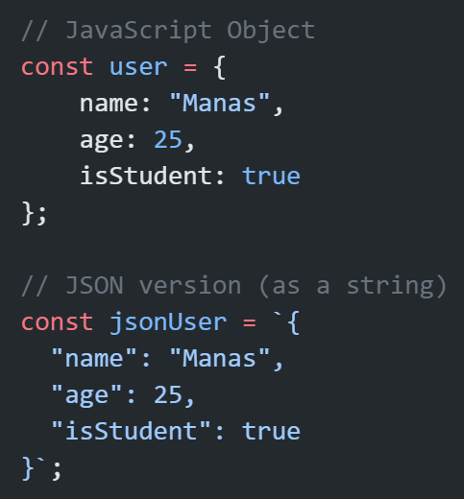
JSON
JSON stands for JavaScript Object Notation.
It’s a lightweight data format used to store and exchange data — like sending data between a browser and a server.
Note:
Keys and string values are wrapped in double quotes.
It's a string, not an object

Slide 4
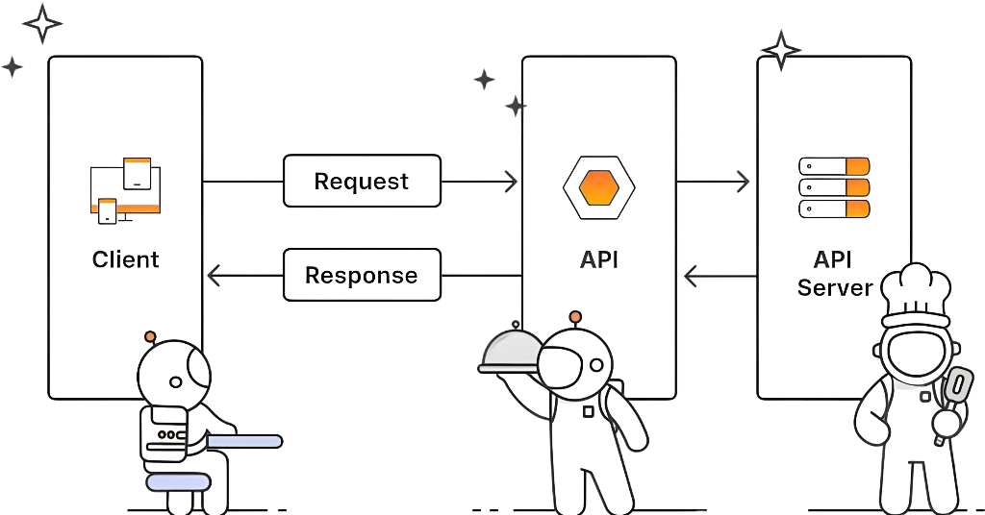

Slide 5
HTTP Methods:
Tells a server what action to perform on a resource, such as creating, reading, updating, or deleting data.
GET: Get/fetch existing data.
POST: Add new data.
PUT: Modify existing data. (Replaces the entire resource)
PATCH: Modify existing data. (update specific fields without affecting others)
DELETE: Remove existing data.

Slide 6
What is Fetch?
Browser ka built-in function
No installation
Returns Promise
Needs to convert JSON into readable JavaScript Ojbect
More code, less features

Slide 7
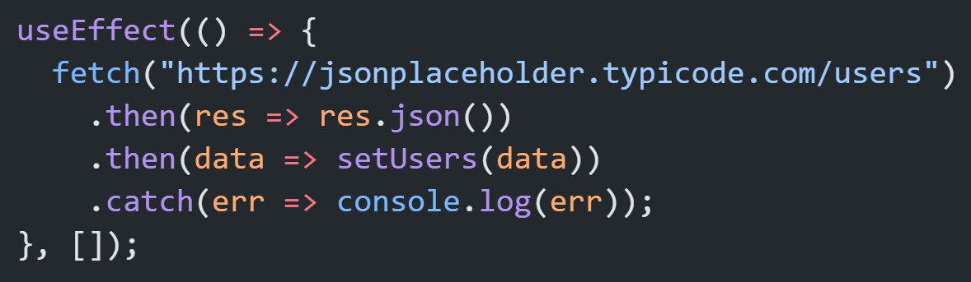
Basic Example

Slide 8
What is Axios?
External library
Clean syntax
Automatic JSON parsing
Better error handling
Interceptors (request/response)
Timeouts inside
Upload/Download progress support

Slide 9
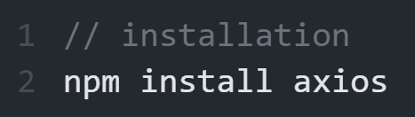
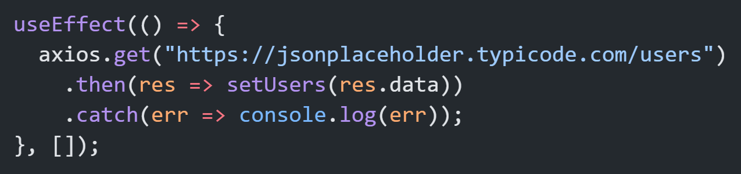
Installation
Basic Example

Slide 10
Fetch vs Axios
Feature | Fetch | Axios
Built-in | ✔ Yes | ✖ No (install)
JSON parse | ❌ Manually | ✔ Automatic
Error handling | Weak | Strong
Upload progress | No | Yes
Interceptors | No | Yes
Timeout | Manual | Built-in
Syntax | Long | Short

Slide 11
Axios

Slide 12
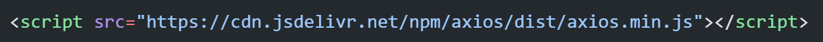
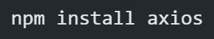
Axios is a popular JavaScript library for making HTTP requests from both browsers and Node.js, simplifying communication with servers to fetch or send data
How to install Axios:
Using CDN:
Using npm:

Slide 13
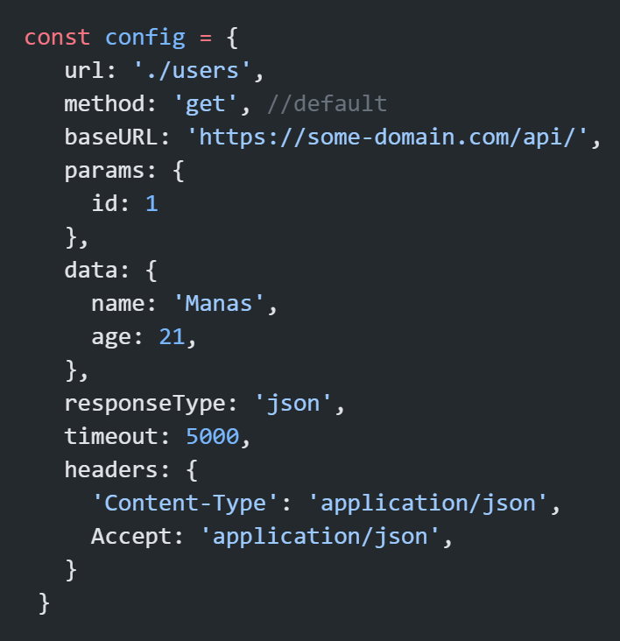
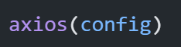
Axios Configuration
These are the available config options for making requests.
Note:
timeout is by default 0 which means no time limit.
some headers are also by default set, so you don’t need to mention such headers. (you can see in browser network tab)
Only the url is required. Requests will default to GET if method is not specified.

Slide 14
Different Response Types
responseType | Used For | responseType
json | API responses (default) | json
text | Plain string / HTML | text
blob | File download | blob (used for images, pdf’s, videos, zip files)
arraybuffer | Low-level binary | arraybuffer (Audio processing, Video stream buffering, Custom binary protocols)
document | XML/HTML | document
stream | Node.js streaming | stream

Slide 15
Shorthand Request Methods
axios.request(config)
axios.get(url, config)
axios.delete(url, config)
axios.head(url, config)
axios.options(url, config)
axios.post(url, data, config)
axios.put(url, data, config)
axios.patch(url, data, config)

Slide 16
Axios
Advanced Features

Slide 17
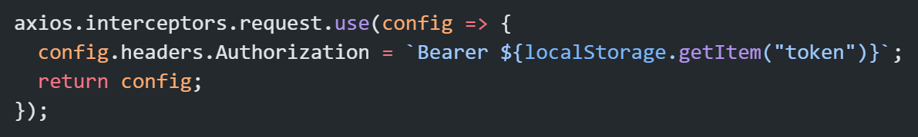
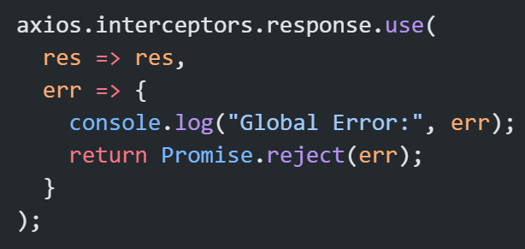
Interceptors
Request ke beech me kuch inject karna.

Slide 18
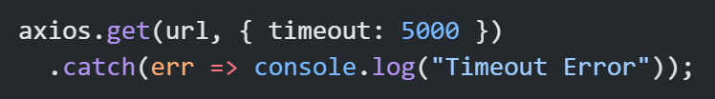
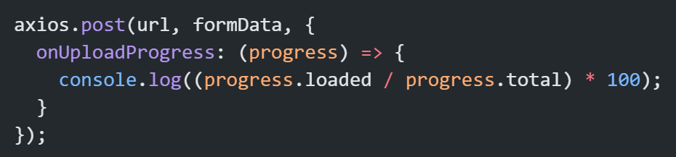
Timeouts
File Upload Progress

Slide 19
Best Practice

Slide 20
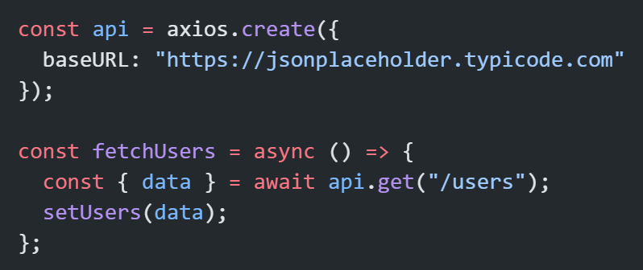
Using Axios instance
You can mention baseURL, default headers, timeout, auth token and common configuration, etc

Slide 21
Instance vs Interceptor
Feature | Axios Instance | Interceptor
Purpose | Reusable axios config | Auto-run logic before request or after response
Handles | baseURL, timeout, headers, etc. | token inject, errors, logging, loader, etc.
Runs | Only when calling | Automatically on every request/response
Without it | Duplicate config in every request | Duplicate logic in every request

Slide 22
Thank You

